Slide 1
ADVOCACY WORKSHOP Clarendon
Facilitator
Notes:
Music Mix Playing: Songs that inspire Advocacy by @HakeemBryan
Advocates use every opportunity to support their cause or issue. Advocacy is a process, not an event. It’s a marathon, rather than a sprint. Let the Games begin.

Slide 2
WHAT WE DO
Give The Youth a Voice
Use media & technology to empower while providing Jobs & Solutions for youth
Building and strengthening a network of various Youth Advocates through media
Provide platforms for youth ages 14-24 to advocate for workable solutions to the issues affecting them, and provide opportunities for youth to demand accountability from local and national representatives elected to serve them.
Notes:
Talk Up Yout is a unique suite of multi-media platforms that gives Jamaican ‘yout’ (dialect for “youth”) a voice, focuses exclusively on issues affecting young people and are produced and driven by young people. Founder, Executive Producer and Chief Advocate Emprezz Mullings-Golding launched Talk Up Yout in 2010 with a weekly TV programme where young guests share experiences, discuss challenges and find solutions to a wide range of issues.
The show’s ground-breaking approach came against the backdrop of a society in which young people continue to be an underestimated and untapped demographic. Their issues are chalked up to the “Generation Gap” and left to fester. Youth participation in decision-making at local and national levels is limited and not well coordinated. The media landscape is dotted with few opportunities for young people to be heard.
It is this phenomena that gave birth to the idea of Talk Up Yout, a simple and clear instruction: talk up youth, let your voices be heard, we want to know how you feel. Emprezz had a vision of how remarkable it would be to share the stories of youths around the country on various media platforms. Stories of pain, disease, violence and despair. Stories of hope, love, success and triumph.
The TV show rapidly grew in popularity for its frank approach to publicly tackling topics such as sexual and reproductive health (SRH), violence, teen pregnancy, suicide, substance abuse, mental health, and disabilities. Many of the SRH issues had never been raised on television like this before.
Soon after the TV show began, the Talk Up Yout producers became inundated with young people showing support for the programme, asking for more outlets to air their views and seeking professional help for their challenges. The team established a website, Facebook and Twitter accounts and a counselling hotline for short-term assistance.
The non-stop demands led to new ideas that have since expanded the movement, beginning with the Talk Up Yout island-wide school tour in 2013 which made stops in each parish to hear directly from high school students. In partnership with UNICEF and other entities, the inaugural Talk Up Yout school tour reached over 3,000 adolescents across Jamaica.
At every school, students in grades 7-11 talked openly and often emotionally about everything from struggles with sexuality and sexual health to physical and emotional abuse and challenges in broken homes.
The interest and demand kept growing and in April 2014, with financial and technical support from UNICEF and the National Family Planning Board (NFPB) Sexual Health Agency, Talk Up Radio was launched in April 2014, as a three-month pilot to extend the reach of Talk Up Yout using a medium that has the highest penetration in Jamaica. The 30-minute programme was aired weekly on RJR, one of the island’s most popular radio stations.
Similar to the TV programme, Talk Up Radio gave young people a platform to discuss a range of topics, chief among them sexual and reproductive health. The show was produced by youth under 20 years old and included music by in-house Disc Jockeys who were teenagers. Guests and co-hosts were all young people under 25. A young aspiring journalist was featured each week with our Roving Report feature, where young people all across the country were encouraged to send in 1-minute news reports using their mobile phones.
Only six years after its debut, Talk Up Yout has become a household name right across the island that is now synonymous with youth upliftment and empowerment.
Talk Up Movement in Brief:
● The Talk Up Yout TV Show began in 2010 and is currently airing Season 7 on Television Jamaica (TVJ) produced by Executive Producers: Stanley & Empress Production, owned by: Emprezz Mullings-Golding and Nadia Stanley. Talk Up Yout gives young people from all across Jamaica a direct opportunity to speak up about issues affecting them, their peers and their communities, discuss these issues with youth from different backgrounds and find solutions together. Talk Up Yout magnifies these youth voices at the local level through our TV show aired in Children's Prime Time. These episodes are then uploaded to YouTube and our social media profiles, bringing the voices of the youth to international audiences including Jamaicans in the diaspora. Talk Up Yout attracts incredible support including hundreds of thousands of live viewers. Our main Investor is National Baking Company with support from the Wisynco brand, Cranwata.
● The Talk Up Yout School Tour continues another season of tours following its successful pilot in 2013. Developed using ethnographic principles - The Talk Up Yout School tours meet students in their spaces using talk therapy to help them articulate the issues they face in an open, non-judgmental, inclusive atmosphere while, engaging them in collaborative conversations about these issues to identify areas in their lives, that need to be addressed by critical stakeholders including the Government and parents. Information they need about Sexual and Reproductive Health, Financial Literacy, Social Awareness and Employability among other topics is also disseminated. All types of schools (co-ed, girls & boys), at all levels of the high school ranks (high-performing and under-performing), are engaged and each year group/age bracket within the school is represented. These sessions are documented using digital media including vlogs and blogs so others may benefit from the information and design appropriate solutions to meet the needs of the students and their communities.
● The Talk Up Radio Show was launched in April 2014 with Executive Director: Emprezz-Mullings Golding and Producer: Kristeena Monteith, then 19-year-old, prospective Journalism student at CARIMAC, University of the West Indies, Mona. The radio show completed its four-month pilot phase later that year and was re-launched on Nationwide 90 FM in 2016. Kristeena, who is still the Producer, is now 23 and a finalizing student, graduating with a BA in Journalism – First Class Honours. She credits Talk Up Radio and the mentorship of Emprezz Golding for providing her with vital leadership experience and an opportunity to hone her skills while learning more about media and communications. With Emprezz' guidance, her media experience of over a decade and her business insights and a growing team of talented young media professionals, Talk Up Radio is becoming a full civic media production organization, providing young people with a supportive, low-stakes environment to learn about, and acquire skills in media production, civic engagement and youth advocacy, while creating quality media content.
● Talk Up Yout - #Youtfichat National Advocacy Programme- The “Youth Empowerment Through Dialogue in Jamaica” project provides a platform for Jamaican youth aged 14-24 years to advocate for workable solutions to the issues affecting them, and demand accountability from local and national representatives elected to serve them. Through 14 town hall meetings, 1400 youth are engaging in direct communication with elected officials and business leaders. At the heart of the project is a capacity-strengthening component, which will train 350 youth advocates across the country. These advocates will mobilize their peers, generate consensus on priority issues and make representation to relevant elected public servants.
Social Good Projects: We play our part in changing the world by connecting our Talk Up Yout' Youth Advocates with opportunities to serve in different capacities for several Social Good Projects in Jamaica such as World AIDS Day Projects, United Nations Sustainable Goals Projects and Community Beautification Projects to name a few. The projects we support target all age groups.
Talk Up Yout Referral Services is a channel through which corporate companies seek young people for jobs and internships. Through our network we connect young people with skills training and work experience opportunities across Jamaica. We assist with grooming and preparing young people for these opportunities and then we refer them to various jobs and positions. Some corporate companies, which have benefited from this service include: Digicel, RJR Gleaner Group of Companies, Nationwide Radio and Jamaica Producers.
Talk Up Yout's Outreach Programmes encourage young people to visit Children’s Homes, galvanizing young people to serve voluntarily in those spaces where there is a need. We collect donations and execute fundraising events to support State care facilities in Jamaica. We also assist in coordinating outreach programmes for visitors and persons from the Jamaican diaspora who want to visit and serve in our local communities.
Youth-Led Media projects provide quality media coverage for corporate businesses. We train and contract young people to capture events, for clients such as RUBiS Energy Limited, United Nations Agencies and the European Union, using photography, videography and print coverage. We train and prepare youth for the media industry and through this experience they develop a network for themselves within Jamaica's creative industry, acquire skills and a means of generating sustainable income.
Talk Up Yout Research: Through years of amassing significant research into youth issues, Talk Up Yout has developed an appreciation for and proficiency in executing qualitative and quantitative research, a service we provide for clients. Our methods include baseline surveys and focus groups. The results we provide for clients have proven valuable in designing and marketing products and services for intended markets and customer segments.
For more information: www.talkupyout.com

Slide 3
TV Shows , School Tours, Outreach

Slide 4
Workshops & Town Halls

Slide 5
Talk Up Radio
Notes:
The Talk Up Radio Show was launched in April 2014 with Executive Director: Emprezz-Mullings Golding and Producer: Kristeena Monteith, then 19-year-old, prospective Journalism student at CARIMAC, University of the West Indies, Mona. The radio show completed its four-month pilot phase later that year and was re-launched on Nationwide 90 FM in 2016. Kristeena, who is still the Producer, is now 23 and a finalizing student, graduating with a BA in Journalism – First Class Honours. She credits Talk Up Radio and the mentorship of Emprezz Golding for providing her with vital leadership experience and an opportunity to hone her skills while learning more about media and communications. With Emprezz' guidance, her media experience of over a decade and her business insights and a growing team of talented young media professionals, Talk Up Radio is becoming a full civic media production organization, providing young people with a supportive, low-stakes environment to learn about, and acquire skills in media production, civic engagement and youth advocacy, while creating quality media content.

Slide 6
Scholarships through Partnerships
Notes:
Through TUY, our Corporate partners are responding to the diverse needs of youth. We advocated for their voices to be heard and encouraged partners to assist.

Slide 7
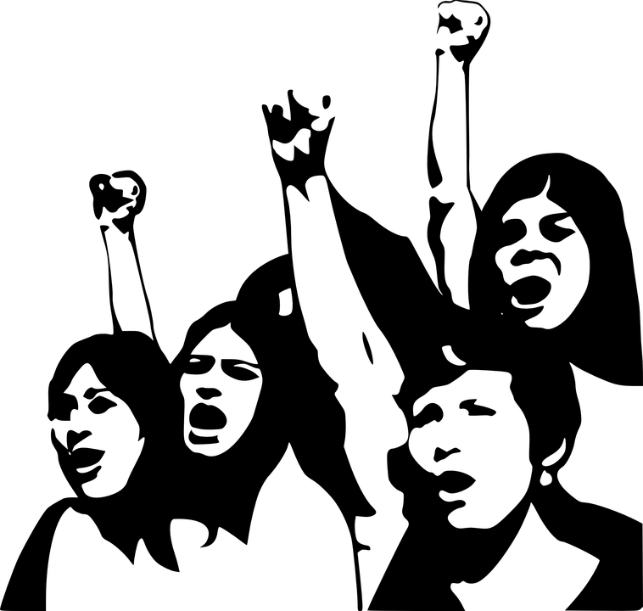
AGENDA
Define Advocacy
Identifying Advocacy Priorities
Develop an Advocacy Agenda
Notes:
Play Kid President Videos –What do you get from his video: ? “ Anyone can….

Slide 8
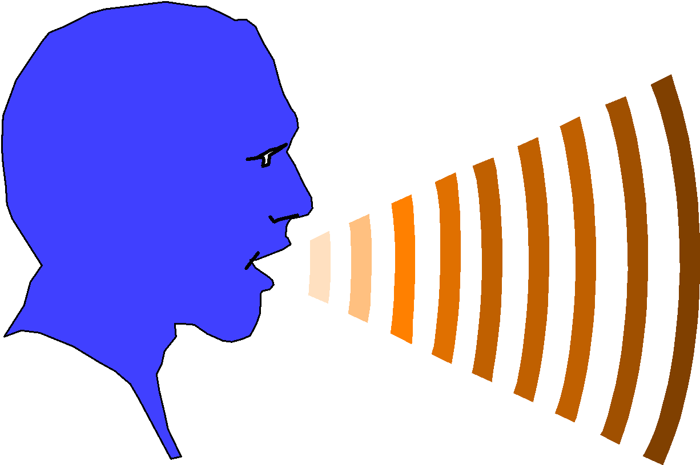
What is Advocacy?
How would you define Advocacy?
Notes:
Write down Key words and definition from the group . Let us see what you understand it to be.

Slide 9
What is Advocacy
It is a process which causes
Change in attitudes + practices
Change in policies and laws
Influences donors, political directorate and technocrats

Slide 10
What is Advocacy cont.
Citizen initiatives
A series of activities
To influence the formulation and implementation of public programmes and policies

Slide 11
-EXPRESSING YOUR VOICE IN SUPPORT OF A CAUSE OR MISSION BY SPREADING THE WORD AND TAKING ACTION. -ADVOCACY IS A PROCESS NOT AN EVENT -IT HAPPENS AT ALL LEVELS, LOCAL, NATIONAL AND INTERNATIONAL -IT IS ABOUT ACHIEVING SPECIFIC OUTCOMES
ADVOCACY IS . . .
Notes:
Ask individuals. If you could fight for something, what would it be?

Slide 12
Who is an advocate
Someone who publicly champions or supports a particular cause or policy
Someone who uses their voice to cause social and political change
Anyone can be an advocate
Collective voices have a greater impact
NGOs- Talk Up Yout, Jamaica Environment Trust (JET), Jamaicans for Justice, Tambourine Army, Jamaica Mental Health Advocacy Network, NIA
Notes:
-The Jamaica Environment Trust (JET) seeks to protect natural resources by strengthening the capacity of communities to protect their own rights using the law and the media to advocate for good environmental management. We use public participation processes to review Environmental Impact Assessments (EIAs), attend public meetings and review national policies. We also conduct campaigns to protect places, ecosystems and biological diversity.
-Founded in 1999, Jamaicans for Justice (JFJ) is a non-profit, non-partisan, non-violent citizens’ rights action organisation that advocates for good governance and improvements in state accountability and transparency. JFJ primarily works with victims whose rights have been breached by members of the security forces spanning unlawful search or detention, to excessive use of force and extra-judicial killings. The organisation tries to help everyone who seeks it help.
-NIA: We are a non-profit organization aimed at combating corruption in Jamaica through education, encouraging anti-corruption vigilance and activism.

Slide 13
Why is Advocacy Important?
Key decision makers react to those credible groups or individuals who most effectively bring their issues to the forefront of the public agenda (or shape the agenda itself)
Governments have competing interests and concerns (including their own priorities)
If you don’t engage, someone else will
You have the power to affect change around your issues (voters, taxpayers)

Slide 14
Some Important Points
A cornerstone piece to advocacy is your personal story or experience
Another critical component is building and sustaining relationships with people that impact your issues (i.e. government officials, elected politicians)
You must find people who share the same story
You must RESPECT opposing views
Advocacy must have a plan, people to monitor it and it needs continuous evaluation
YOU can be an Advocate!

Slide 15
Our success (and our future) depends on the strength of our advocacy. ADVOCACY REQUIRES LARGE NUMBERS OF MOTIVATED INDIVIDUALS
Notes:
On any given day our legislators have so many interests competing for their attention: the war, highways, education, the economy, elderly issues, childcare… so unless they hear from us in large numbers, we won’t be successful.

Slide 16
Types of Advocacy
Various types of advocacy
Self Advocacy
Group Advocacy
Peer Advocacy
Citizen Advocacy
Legislative Advocacy
Notes:
Presenter Renee Johnson to explain!

Slide 17
Types of Advocacy
Self Advocacy- Making informed decisions on important issues based on one’s right and bringing the necessary change into reality.
Peer Advocacy- When someone who has had the same experience, or has similar characteristics supports another person. Normally, done one on one.

Slide 18
Types of Advocacy
Professional Advocacy- paid individual advocates assist others to speak up for their rights, usually in a time of crisis.
Legislative Advocacy- efforts to influence the introduction, enactment or modification of legislation. It means lobbying law makers to vote in a particular way.

Slide 19
Types of Advocacy
Group/Community Advocacy- Groups of individuals with similar experiences, values and concerns coming together to create a voice to influence public opinion and policy
Citizen Advocacy- involves people in their communities influencing the outcome of issues in their communities based on their rights, knowledge and needs. Citizen advocacy may form partnerships as necessary.

Slide 20
Examples of Global Youth Advocacy Efforts
Vote Like a Boss in Guyana
Roshni in India
Notes:
Presenter Sujae Boswell will speak for 5 minutes as one of our lead advocates to show how youth are making a difference.
Other attempts- USA: Take a Knee and #BlackLivesMatter

Slide 21
Road Blocks to Advocacy
Lack of comfort with the advocacy process
Don’t know where to start
Don’t know where to get help
Don’t feel you are “expert” enough to advocate
Notes:
Most people are somewhat intimidated by the idea of advocacy. They believe that you need to be an expert or professional to advocate. Maybe some of you here today feel that way. I hope during this session I can increase your comfort level with the advocacy process and help connect you to the resources available to support your advocacy efforts. Everyone here can be an effective advocate for a cause affecting you and your peers. Let’s get started by walking through the steps to building and implementing your advocacy strategy.

Slide 22
Build Your Advocacy Strategy
Identify the issue - what is your need, concern, or problem to be addressed?
Is it a local, parish, state, Province, Federal or National issue?
Is it a legislative issue or an administrative one?
Who can address the issue for you in the correct venue?
Notes:
In building your strategy, you may need to do some research. In fact, I recommend it. If you believe an issue needs to be addressed, make sure that you understand all sides of that issue. For example, if you believe that your country /Government should increase its funding for youth with disabilities, you should be sure to learn about what funding levels have been over recent history, and what the rate of increase has been, what is the source of funding for YOUTH issues and what individuals or groups have been in favor or opposed to that funding.

Slide 23
Techniques and Tactics of Advocacy
Sensitizing
Mobilizing
Negotiating
Lobbying
Petitioning
Informing

Slide 24
Key steps for strategy formulation
Identification and analysis of advocacy issues
Identification and analysis of stakeholders
Formulation of measurable objectives
Developing core advocacy messages
Developing the strategy ( approaches, techniques, messages and materials)
Developing advocacy action plan
7. Planning monitoring and evaluation

Slide 25
Key components of Advocacy message (5)
Key points to be addressed:
Description of the issue/problem
Magnitude of the issue/problem
Adverse impact of the problem on the population or groups of population
.What the stakeholder can do to
address the issue

Slide 26
ADVOCACY IN ACTION Effective Advocacy & Mobilization
What is your change agenda and how do you achieve it?
Advocate.
Notes:
Form 5 groups of 6 to create 5 Important global issues that needs addressing

Slide 27
ACTIVITY: Define Priority Problem/Issue
Description of priority problem and its causes | Reason for choosing this problem | Who is affected by the this problem | Recommended tentative solution in terms of advocacy
Define the problem. Explain why it is an issue *** Eg- Increased Teenage Pregnancy Eg. Road Accidents among youth | Why is it happening? Make sure to source data from newspapers, research etc *** Rape & Peer to Peer Unprotected Sex Increased marijuana edibles since the legalization of ganja | Who is being affected? Identify the main group and any or indirect/ secondary groups and explain the Impact *** Teens, Babies, parents of teens Several youth have lost their lives and limbs. Therefore impact on the development of the society . Teen Parents Hospitals- increased trauma | - Advocacy Policy for Sexuality Education in Schools and Workplaces Lobbying Ministry of Health to create more educational campaigns on Marijuana use. Formalise the distribution of edibles, approved by Bureau of Standards
Notes:
Activity 1 in groups. Choose a problem, Reason, Who is affected by this problem and Recommend a tentative solution in terms of advocacy. (TUY Team to assist in the Recommendations)

Slide 28
ACTIVITY: Develop Your Strategy
Strategy, Objectives & Activity | Partners | Time Line | Responsible Person | Budget
Objective: The aim of the advocacy. What is your intention? What is the hopeful outcome How are you going to achieve your objective or outcome What are activities are you going to employ to get your outcome | Who is going to help you achieve your outcome. Advocacy plans can be more effective if partners are involved and reduced duplication | Realistic Time line to achieve objective. It may be years . | Who from your team or which one of your partners is responsible for this action | Items: Activities Media Distribution Fliers, items Staffing Logistics
Notes:
Activity 1 in groups. Choose a problem, Reason, Who is affected by this problem and recommend a tentative solution in terms of advocacy. (TUY Team to assist in the Recommendations)

Slide 29
Monitoring and Evaluation
Is one of the most Important elements in an advocacy plan

Slide 30
1. Advocacy Action Plan Matrix
Definition of Problem | Reason for choosing Problem | Who is affected by the Problem | Recommend a solution in terms of Advocacy
Notes:
In your own time use this Matrix to develop your advocacy action plan.
Develop the process
The timelines
Identify the role of those to be involved
Role of allies and partner agencies
Advocacy Plan
-Objective: The aim of the advocacy? What is your intention? What is the hopeful outcome
Strategy
Activity
Partners
Time Line
Responsible Person
How are you going to achieve your objective or outcome
What are activities are you going to employ to get your outcome
Who is going to help you achieve your outcome
Realistic Time line to achieve objective. It may be yeards
Who from your team or which one of your partners is responsible for this action
Resources to be used
Resources to be used

Slide 31
2. Advocacy Action Plan Matrix
Strategy, Objectives & Activities | Partners | Timeline | Responsible Person | Budget
Notes:
In your own time use this Matrix to develop your advocacy action plan.
Develop the process
The timelines
Identify the role of those to be involved
Role of allies and partner agencies
Advocacy Plan
-Objective: The aim of the advocacy? What is your intention? What is the hopeful outcome
Strategy
Activity
Partners
Time Line
Responsible Person
How are you going to achieve your objective or outcome
What are activities are you going to employ to get your outcome
Who is going to help you achieve your outcome
Realistic Time line to achieve objective. It may be yeards
Who from your team or which one of your partners is responsible for this action
Resources to be used
Resources to be used

Slide 32
Advocacy Tips
Be confident. Tell your story and share your experiences with your elected leaders.
Be knowledgeable of the issues.
Be honest and use plain language; be polite.
Speak from the heart, but don’t over-tell your story.
Stay on message.
Ensure that your group reflects the diversity of your community and agencies.

Slide 33
Advocacy Tips
What doesn‘t work?
A confrontational style that harasses or insults politicians;
Members who are under-informed or are speaking to issues without conviction;
Providing members with tools that make them look like wound-up robots.
Notes:
Patience..

Slide 34
Key approaches used in advocacy
Involving leaders
Working with mass media
Building partnership
Mobilizing the community groups
Capacity building

Slide 35
Advocacy Tools
Make the most of technology to:
research a particular position;
monitor government positions;
organize, mobilize, and communicate with members;
promote a viewpoint, attract supporters and organize campaigns.
Use Social Media
Notes:
Social media is one of the most powerful and cost-effective tools available to advocates today. Blogs, Facebook pages, Tweets, Linkedin, Google Plus and more are all cost-effective ways to share your message and increase constituents’ understanding of the issues that you are working on.

Slide 36
Time to TAKE ACTION, . . .
Participate in an event, meet your Members of Parliament in person
Call your Members of Parliament
Email your Members of Parliament
Sign a petition
Share something on Facebook or Twitter
Notes:
Groups quickly present in 2 minutes each their Priority Issue and Problem.

Slide 37
Shaneil Salmon 2nd year Student, UWI UNESCO Jamaica Youth Ambassador UWI Vice Chancellor Ambassador

Slide 38
Mobile Journalism
It's Pixel Perfect
Notes:
Mobile journalism is an emerging form of new media storytelling where reporters use portable electronic devices with network connectivity to gather, edit and distribute news from his or her community.
Mobile Journalism is what TUY believes is the best tool for peer-to-peer/community-level youth advocacy.
Social media is one of the most powerful and cost-effective tools available to advocates today. Blogs, Facebook pages, Tweets, Linkedin, Google Plus and more are all cost-effective ways to share your message and increase constituents’ understanding of the issues that you are working on.

