Slide 1
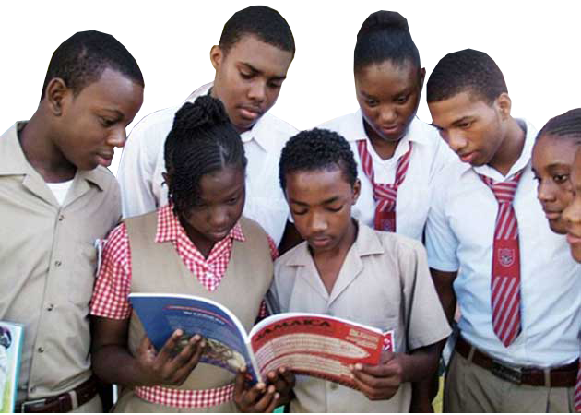
WHAT IS THE CONSTITUTION?

Slide 2
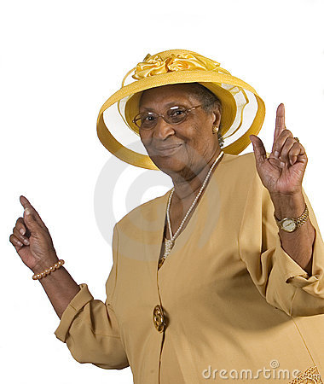
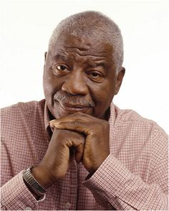
THE CONSTITUTION?
In every household, there are a set of rules set by your mother and father, aunt or uncle, grandma or grandpa, or even your big sister or brother that you must abide by.
If you disobey these rules, there are usually consequences which may lead to a punishment of some sort.
It is the same with the country. A set of rules that each and every citizen, including our leaders themselves must follow.
Notes:
Unuh eva hear about man a yaad?
Yes the constitution a the Don dadda of our laws (there is no other law above it)

Slide 3
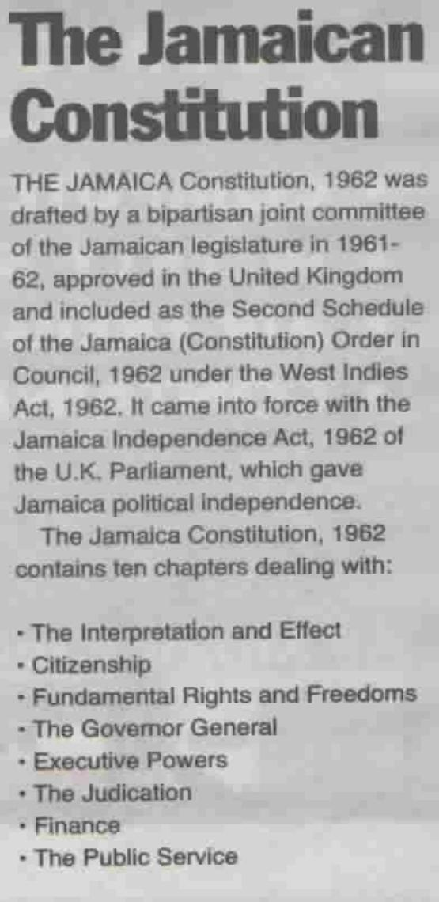
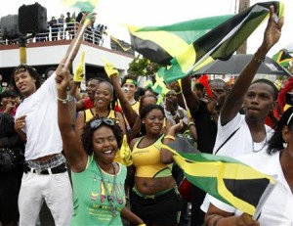
What is The Constitution
The constitution is a set of rules otherwise known as the general principles of governance. The constitution is the highest law in Jamaica.
Notes:
insert video 1

Slide 4
The constitution guides the relationship between the government and the people of the country and helps us to maintain law and order.
Notes:
Insert video 1
If we go back to the household, we can see that there are different rules for different situations.
For example, how we speak to our parents or guardians, how we use the kitchen, bathroom or living room or who is responsible for cleaning. Within the country, the concept is quite similar.
The law is there to determine who does what and when. Also, the law determines how each man, woman, boy or girl, property or the environment is treated.

Slide 5
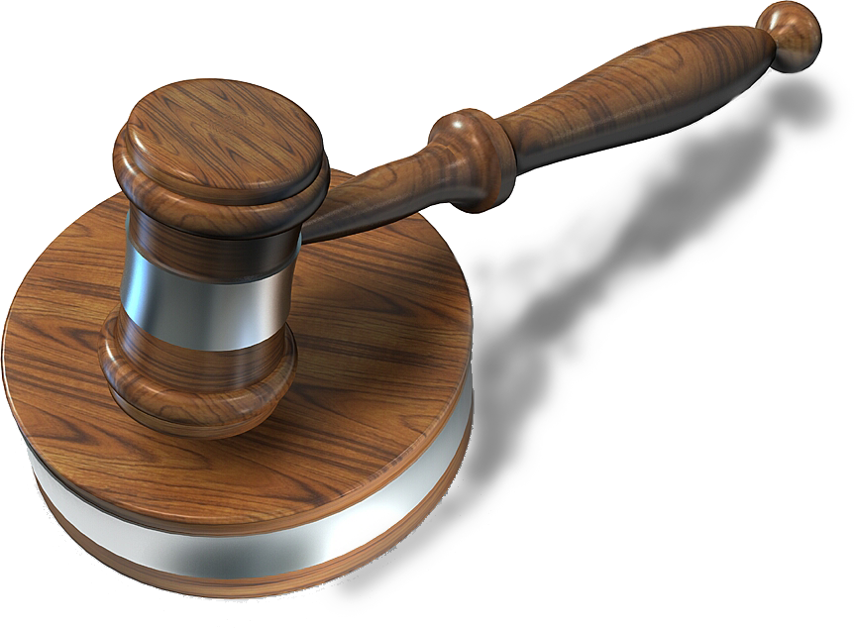
WHY DO WE NEED A CONSTITUTION?
A constitution is needed so that:
We always have law and order
Everyone knows what is right from wrong
Everyone keeps out of trouble
Notes:
Insert video 2

Slide 6
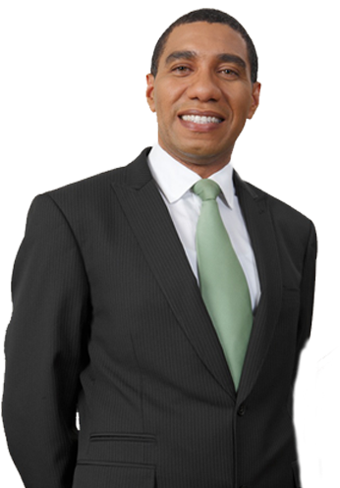
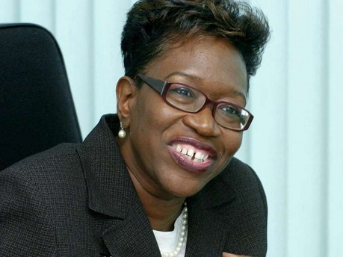
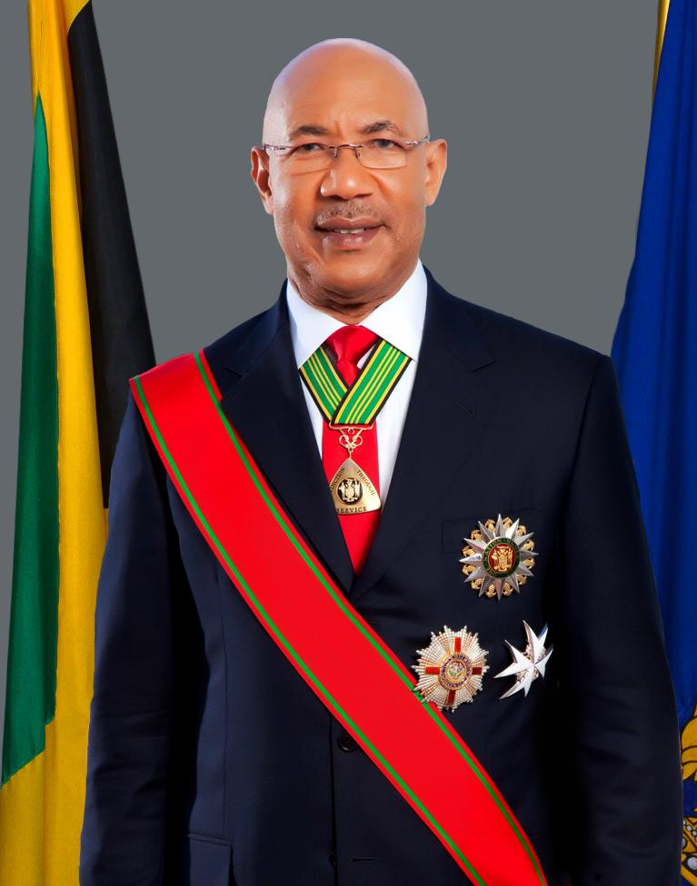
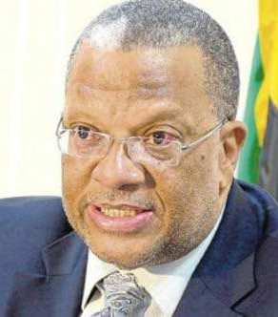
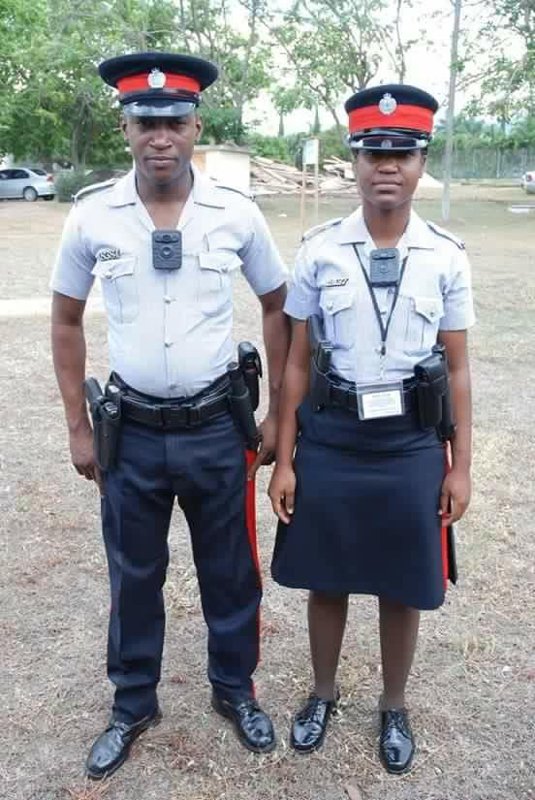
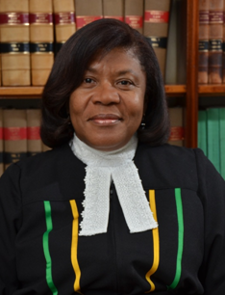
LET’S RECAP
The constitution is the highest law of Jamaica
Even the Prime Minister and Governor General, police, judges and lawyers must follow the constitution
As citizens, you must know the constitution so that you can know when someone is not doing the right thing and hold them accountable
Notes:
Know the constitution to ensure that you are within your rights and responsibilities.
You can report ‘wrong doing’ to the police or you can take the matter to court in any case in which the constitution is not being followed.
Also, if you get into trouble with the police, once you know the constitution, you can determine if you are being treated correctly and fairly. If not, you can challenge the police because you know your rights and your rights must be protected.

Slide 7
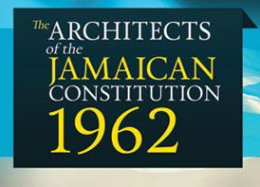
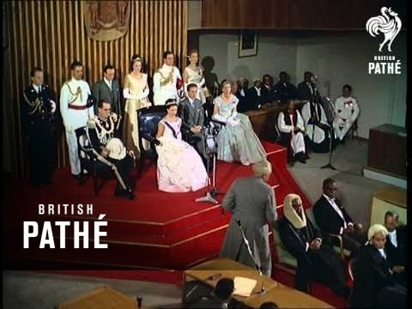
Other facts about the constitution
It was developed in 1962 which is the same year Jamaica received its independence from Britain
It took those leaders of government in 1962 only (four (4) months to develop the constitution. There was also four (4) weeks of consultations with ordinary citizens like you and me as well as civil servant groups which included police, soldiers, teachers and nurses among other stakeholders such as human rights groups
Edward Seaga, Jamaica's 4th prime minister is the only living person to have signed the constitution
Notes:
Can you imagine a time without internet and computers and tablets which must have been difficult?

Slide 8
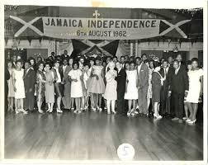
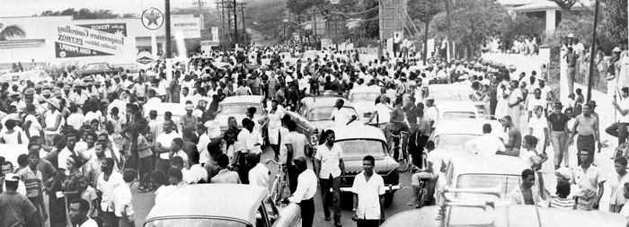
Signing of the Constitution 1962

Slide 9
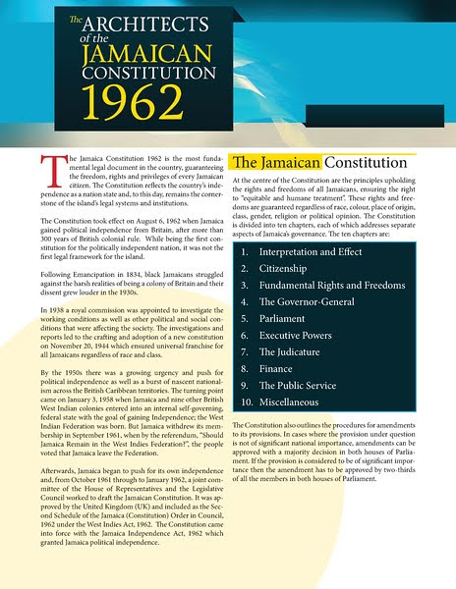
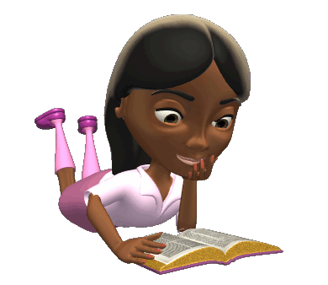
THE CONSTITUTION HAS 10 CHAPTERS:
Preliminary
Citizenship
Fundamental rights and freedoms
The Governor General
Parliament
Executive powers
The judicature
Finance
The public service
Miscellaneous
Notes:
Insert video 3

Slide 10
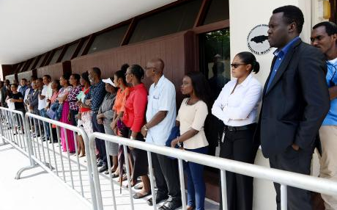
What are rights?
Our rights are what every human being deserves, no matter who they are or where they live. This allows us to live in a Jamaica that is fair and just.

Slide 11
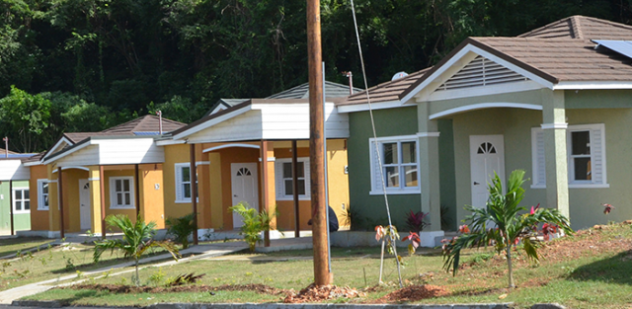
As Jamaicans, we have the rights to:
Safety
No matter who you are or where you live, if you request police presence for whatever reason, they are required by law to be there.
Education
We have the right to education. In Jamaica, no citizen can be denied access to government owned educational institutions at the early childhood and primary level.
Housing & basic amenities
All of us deserve somewhere to live, food to eat and clothes to wear. However, we must acquire these things lawfully.

Slide 12
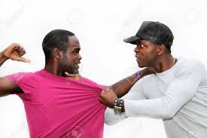
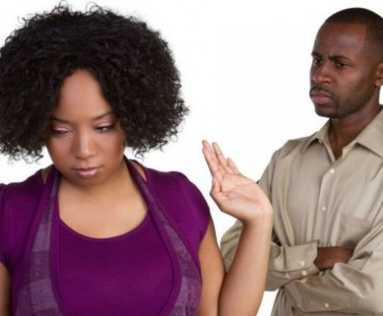
Rights Cont’d
Freedom of speech
We also have a right to freedom of speech. While this is true, we must remain respectful to each other so that we do not harm each other verbally or even physically.
Let us remember that with freedom, there is great responsibility and consequences for our actions.
Examples of how freedom of speech can cause conflict

Slide 13
Rights Cont’d
Right to vote
The right is very important as we have the opportunity to select persons to represent our best interests in the house of parliament where laws are made, and resources are allocated.
With this right to vote, we are able to hold these representatives accountable to their actions.
Notes:
In summary…
Rights provide a common standard as to how people should treat others and how they expect to be treated in return.
Key Features of Electoral Democracy:
One Man/woman…one vote
Regular elections
Any group can form political party & field candidates
Almost all places in the legislature are contested
“Fair” election campaigns…without coercion
Secret voting
Accurate counting of votes

Slide 14
Core Human Rights Principles
Inalienable – the rights that individuals have cannot be taken away, surrendered, or transferred.
Universal – everyone is born with and possesses the same rights, regardless of where they live, their gender or race, or their religious, cultural or ethnic background.
Equal & non-discrimination– all human beings are born free and equal in dignity and rights. It ensures that no one is denied the protection of their human rights based on some external factors such as religion or political persuasion
Participation & inclusion: all people have the right to participate in and access information relating to the decision-making processes that affect their lives and well-being.
Notes:
Other Principles of Human Rights
Inclusion
Respect/Respect for Diversity
Tolerance
Cooperation
Solidarity
Responsibility

Slide 15
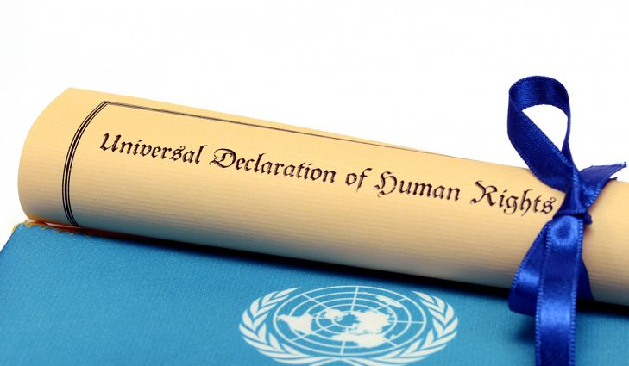
Universal Declaration Of Human Rights
The declaration came about directly from the experiences of the second world war and represents the first global expression of what many people believe to be the rights to which all human beings are naturally entitled. The horror of the war resulted in an international conscience that demanded protection of human rights by the governments of the world.

Slide 16
Give some examples of Human Rights…

Slide 17
LET’S WATCH THIS…
HTTPS://YOUTU.BE/JPY9S1AGBSW

Slide 18
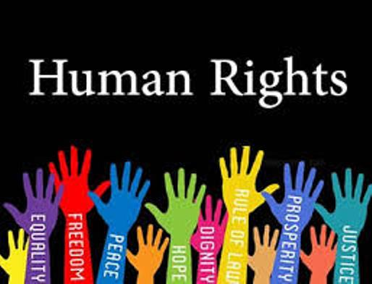
The UDHR is the minimum and common standard of achievement for all peoples. The united nations general assembly adopted it on December 10, 1948, the day which continues to be observed internationally as human rights day.
The influence of the universal declaration of human rights (UDHR) has been substantial. Its principles have been incorporated into constitutions of countries in the united nations including Jamaica, making it constitutional law.

Slide 19
Human rights and the charter of fundamental rights and freedoms
The charter of fundamental rights and freedoms (CFRF) was based on the UN Declaration of Human Rights as well as European Right
The charter protects our rights as citizens of Jamaica
The CFRF was amended in 2011
It has 19 rights in total
Notes:
Video 4

Slide 20
CHAPTER 3 (13)
The right to life, liberty and security of the person and the right not to be deprived thereof except in the execution of the sentence of a court in respect of a criminal offence of which the person has been convicted;
The right to freedom of thought, conscience, belief and observance of political doctrines;
The right to freedom of expression;
The right to seek, receive, distribute or disseminate information, opinions and ideas through any media;

Slide 21
CHAPTER 3 (13) CONT’D
The right to freedom of peaceful assembly and association;
The right to freedom of movement
The right to equality before the law;
The right to equitable and humane treatment by any public authority in the exercise of any function;
The right to freedom from discrimination on the ground of: (i) being male or female; (ii) race, place of origin, social class, colour, religion or political opinions;

Slide 22
CHAPTER 3 (13) CONT’D
The right of everyone to: (i) protection from search of the person and property; (ii) respect for and protection of private and family life, and privacy of the home; and (iii) protection of privacy of other property and of communication;
The right of every child: (i) to such measures of protection as are required by virtue of the status of being a minor or as part of the family, society and the state; (ii) who is a citizen of Jamaica, to publicly funded tuition in a public educational institution at the pre-primary and primary levels;

Slide 23
CHAPTER 3 (13) CONT’D
The right to enjoy a healthy and productive environment free from the threat of injury or damage from environmental abuse and degradation of the ecological heritage;
The right of every citizen of jamaica: (i) who is qualified to be registered as an elector for elections to the house of representatives, to be so registered; and (ii) who is so registered, to vote in free and fair elections;

Slide 24
CHAPTER 3 (13) CONT’D
The right of every citizen of Jamaica to be granted a passport and not to be denied or deprived thereof except by due process of law;
The right to protection from torture, or inhuman or degrading punishment or other treatment;
The right to freedom of the person;
The protection of property rights;
The right to due process; and
The right to freedom of religion
Notes:
Some of the rights in the CFRF in Jamaica are unique to Jamaica
Let’s listen to our constitutional experts tells us why
Insert 12:12-13:36
video 5

Slide 25
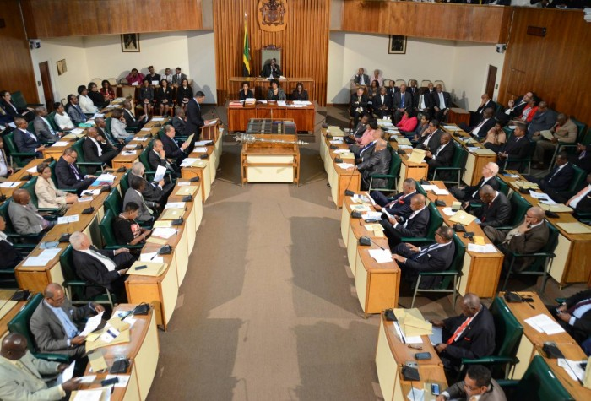
Constitutional Reform
This is the process of amending the constitution
In order to change the constitution one of the following is needed:
If ordinarily entrenched- simple majority in both houses
If entrenched- 2/3 majority in both houses
If deeply entrenched 2/3 majority in both houses plus a referendum
Constitutional reform has to be bi-partisan
21 members in the senate, in order for a 2/3 majority it needs an opposition member to vote with the ruling administration
A referendum is similar to an election- the people have to vote on the issue to be reformed
Insert 4:10-6:42
Notes:
Fixed Election Dates
Citizenship of Parliamentarians
Impeaching the Prime Minister
Recall of MPs and Councillors
Removing the Queen as the Head of State
Introducing the Caribbean Court of Justice as the final court
What are views on these matters?
video 6

Slide 26
Any Questions/Comments?
Notes:
Email TUYPRESS@GMAIL.COM
Watch our video on what is the Constitution? Here: https://www.talkupyout.com/youtfichat-undef.html

